Slide 1
Amortized Analysis

Slide 2
Amortized Analysis
In an amortized analysis, the time required to perform a sequence of data-structure operations is averaged over all the operations performed.
Amortized analysis can be used to show that the average cost of an operation is small, if one averages over a sequence of operations, even though a single operation within the sequence might be expensive.
Amortized analysis differs from average-case analysis in that probability is not involved

Slide 3
Amortized Analysis
There are three most common techniques used in amortized analysis.
Aggregate Analysis
Accounting Method
Potential Method
Here we will discuss only Potential method.

Slide 4
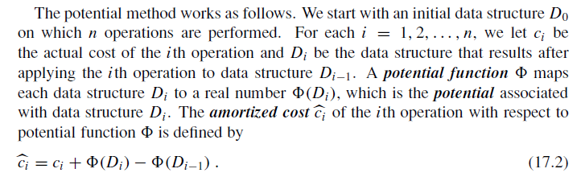
Potential Method

Slide 5
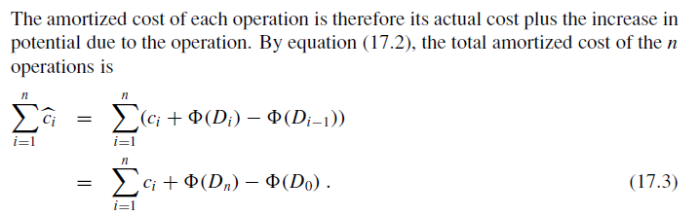
Potential Method

Slide 6
Potential Method
If Φ(D_{n}) ≥ Φ(D₀), then total amortized cost is an upper bound of total actual cost.
But we do not know how many operations, so Φ(D_{i}) ≥ Φ(D₀) is required for any i.
It is convenient to define Φ(D₀)=0,and so Φ(D_{i}) ≥0, for all i.
If the potential change is positive (i.e., Φ(D_{i}) - Φ(D_{i-1})>0), then c_{i}' is an overcharge (so store the increase as potential),
otherwise, undercharge (discharge the potential to pay the actual cost).

Slide 7
Potential method: stack operation
Potential for a stack is the number of objects in the stack.
So Φ(D₀)=0, and Φ(D_{i}) ≥0
Amortized cost of stack operations:
  PUSH:
    Potential change: Φ(D_{i})- Φ(D_{i-1}) =(s+1)-s =1.
    Amortized cost: c_{i}' = c_{i} + Φ(D_{i}) - Φ(D_{i-1})=1+1=2.
  POP:
    Potential change: Φ(D_{i})- Φ(D_{i-1}) =(s-1) –s= -1.
    Amortized cost: c_{i}' = c_{i} + Φ(D_{i}) - Φ(D_{i-1})=1+(-1)=0.
  MULTIPOP(S,k): k'=min(s,k)
    Potential change: Φ(D_{i})- Φ(D_{i-1}) = –k'.
    Amortized cost: c_{i}' = c_{i} + Φ(D_{i}) - Φ(D_{i-1})=k'+(-k')=0.
So amortized cost of each operation is O(1), and total amortized cost of n operations is O(n).
Since total amortized cost is an upper bound of actual cost, the worse case cost of n operations is O(n).

